Slide 1
1-4 THE INTERNET
The Internet has revolutionized many aspects of our daily lives. It has affected the way we do business as well as the way we spend our leisure time. The Internet is a communication system that has brought a wealth of information to our fingertips and organized it for our use.
Topics discussed in this section:
A Brief History
The Internet Today (ISPs)
1.<number>
Notes:
1.#

Slide 2
Definitions
Internet
  A collaboration of more than hundreds of thousands interconnected networks that use TCP/IP for data exchange.
  Came into being in 1969, called ARPANET
  Founded by Advanced Research Projects Agency (ARPA) in Department of Defense for funded projects to share resource.

Slide 3
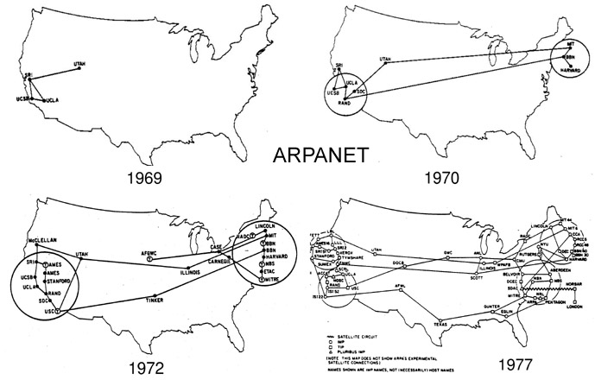
Advanced Research Projects Agency Network (ARPANET): initially a small network of connected computers that connect each host computer with a specialized computer called an interface message processor (IMP). IMP communicates with other IMPs and its attached host..

Slide 4
Evolution of Internet
1973, a Transmission Control Protocol (TCP) is presented by Vint Cerf and Bob Kahn to achieve end-to-end delivery of packets through gateways.
Then TCP is split into Transmission Control Protocol (TCP) and Internetworking Protocol (IP), so called TCP/IP.
In 1981, UC Berkeley modified the UNIX to include TCP/IP , the library functions are called socket Interface.
In 1984, TCP/IP became the official protocol for the ARPARNET

Slide 5

Internet Service Providers (ISPs)
Backbones and provider networks are also called Internet Service Providers (ISPs)
Backbones also referred as international ISPs
Provider networks referred to as national or regional ISPs.

Slide 6

Hierarchical organization of the Internet
ISP: Internet Service Provider
Provide Internet access services to users
Hierarchy
  International ISP
  National ISP
  Reginal ISP
  Local ISP

Slide 7
Hierarchical organization of the Internet
International ISP
  ISP that connects nations together.
National ISP
  Backbone networks created and maintained by specialized companies.
  National ISP’s are connected by NAPs (network access points) for accounting and policing rules regulation.
Reginal ISP
  Connect to national ISP for Internet services
Local ISP
  Provide internet access services to users, e.g. universities, companies, ..

Slide 8

Q3. what is the type of network for A LAN in my home?

Slide 9
Q4. what type of network is TANet (Taiwan Academia Network)?

Slide 10
Q5. what type of network is Yuan-Ze Campus Network?

Slide 11
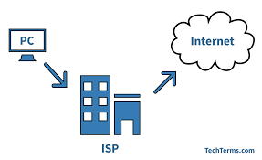
ACCESSING THE INTERNET

Slide 12
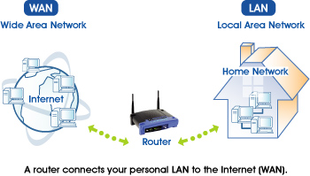
Users need to be physically connected to an ISP through a point-to-point WAN.
Point to point WAN

Slide 13

Accessing Internet (1)
Using telephone networks
  Most telephone networks have already been connected to the Internet.
  So we can just change the voice line between the residence or business and telephone center to a point-to-point WAN.

Slide 14
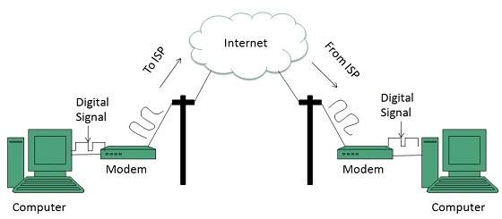
Two ways to convert data to voice (1)
Dial-up service
  Convert data to voice (4KHz) like to make a phone call
  The computer dials the ISP and imitates making a telephone connection.
  Dial-up service is slow and cannot be used by voice connection when connected to Internet.

Slide 15

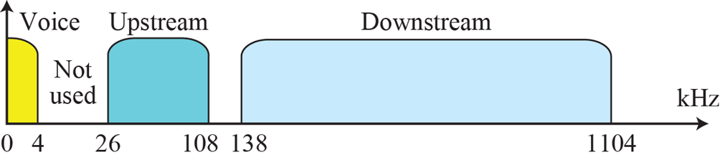
X can be an alphabet to represent the service provided.
xDSL(digital subscriber line) service
  Reuse existing telephone lines but with large bandwidth up to 1.1MHz
  Provide both voice and data channel simultaneously
For point-to-point WAN

Slide 16
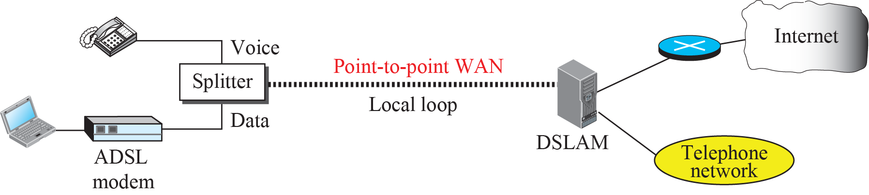

ADSL point-to-point network
ADSL: Asymmetric DSL
Figure 14.9:

Slide 17

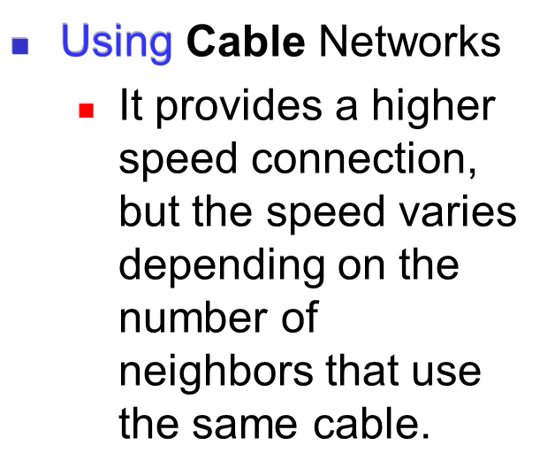
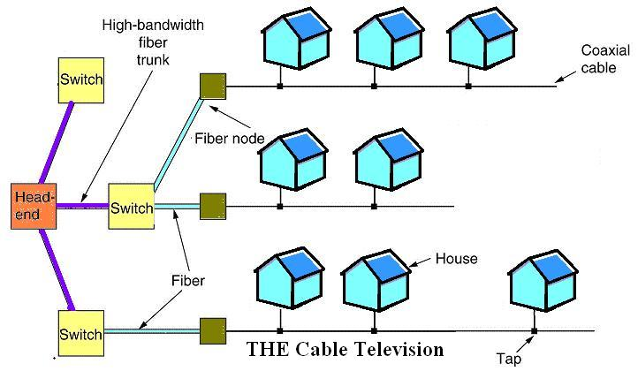

Slide 18

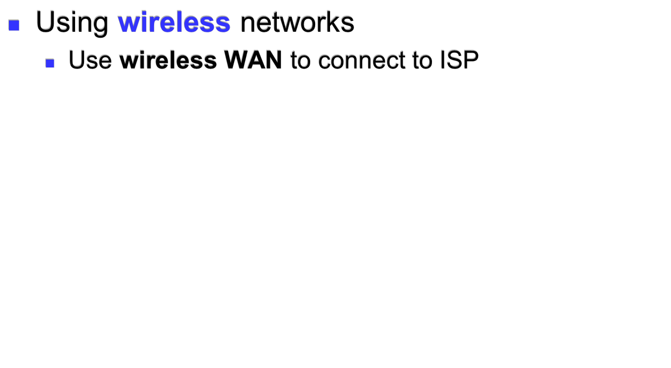
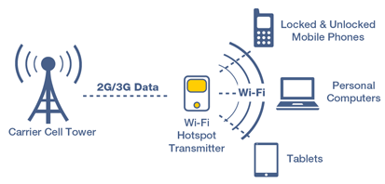

Slide 19

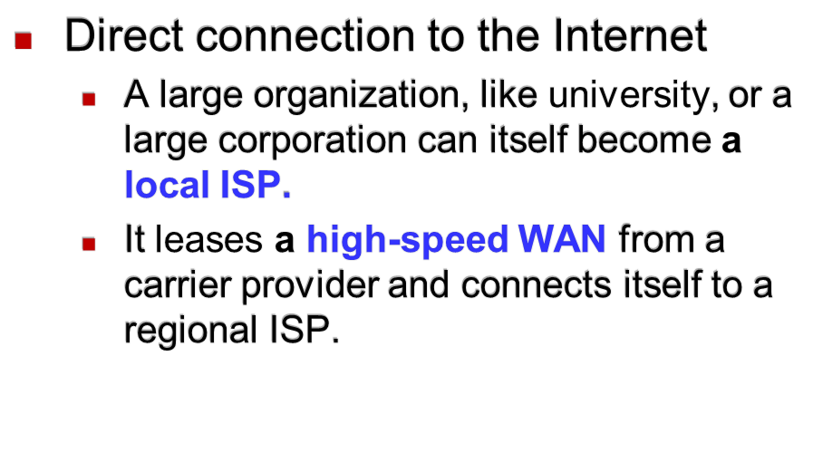
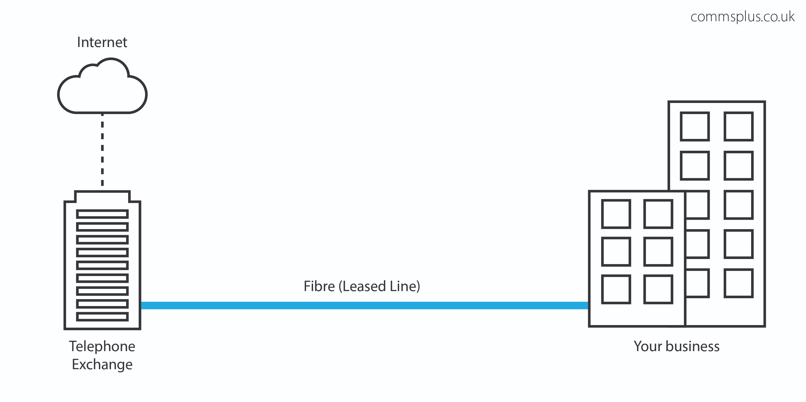

Slide 20
1.5 Protocols and Standards
Protocols
Standards
Standards Organizations
Internet Standards

Slide 21
Protocols
A set of rules that govern data communications, including elements
  Syntax
    The structure or format of the data, meaning the order in which they are presented.
  Semantics
    The meaning of each section of bits, and what action is to be taken.
  Timing
    The timing sequence of messages exchanges. Also indicate when data to be sent and how fast they can be sent.

Slide 22
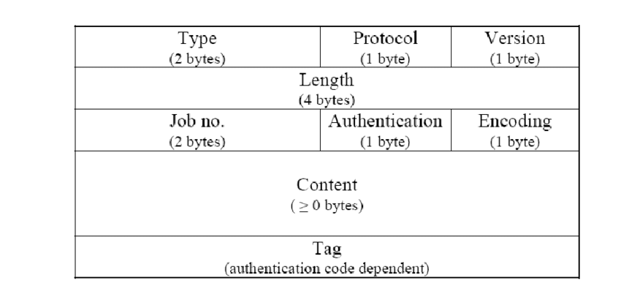
Example of a standard message format
Message Header

Slide 23
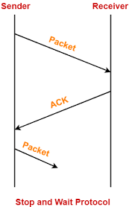
Example: Stop and Wait Protocol
The sender stop sending the next packet until it receives ACK from the receiver.

Slide 24
Rules for Sender (protocol)
Step 1: Send a packet
Step 2: Wait for an acknowledgement (ACK)
Step 3: If ACK is received in T (a limited time)
  Finish
Otherwise
  Retransmit the packet
  Go to step 2

Slide 25
Standards
Provide guidelines to manufactures, vendors, government agencies, and other service providers to ensure interconnectivity.
  De facto
    Standards that have not been approved by an organized body but have been adopted as standards through widespread use.
  De jure
    Standards legislated by an officially recognized body.

Slide 26
Internet Standards
A thoroughly tested specification that is useful to and adhered to by those who work with the Internet.
Process procedure
  Internet draft
    Working document
  Request for Comment (RFC)
    After a draft is recommended, it is published as a RFC, with an assigned number.
    An RFC goes through maturity levels.

Slide 27
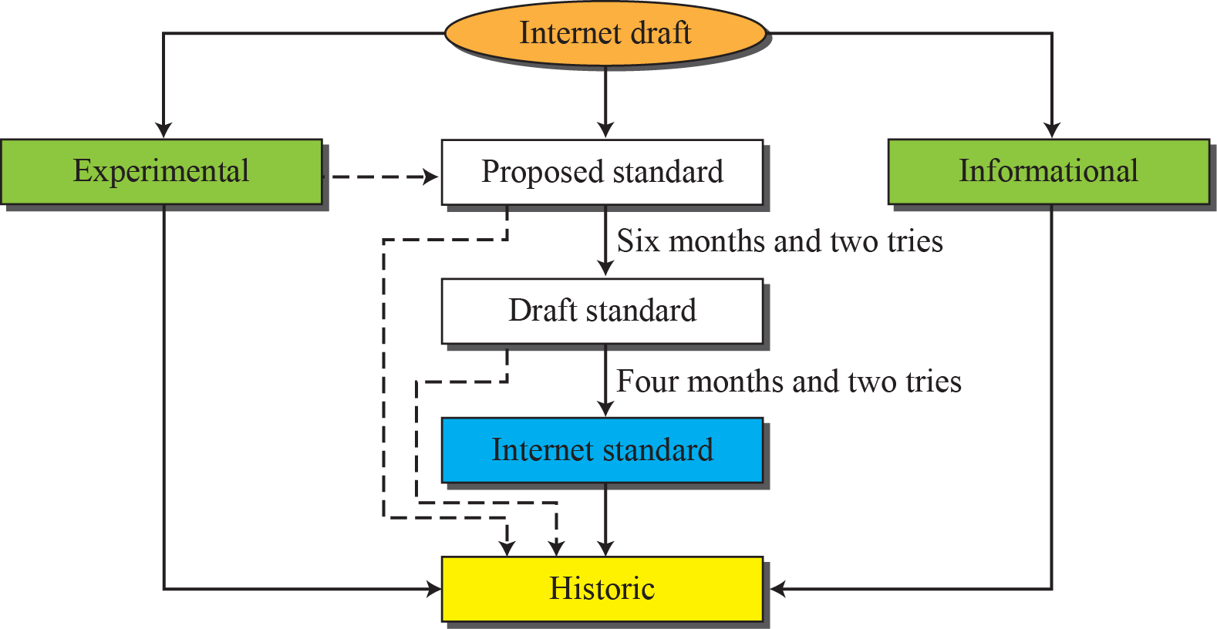
Maturity levels of an RFC
Proposed standard: A specification that is stable, well-understood and of sufficient interest to the Internet community
Draft standard: at least two successful independent and interoperable implementations of a proposed standard.
Internet standard: after demonstration of successful implementation
Describe work related
to an experimental situation
Historical, tutorial
information

Slide 28
Internet Architecture Board (IAB)
IETF (Internet Engineering Task Force) is a forum of working groups )
Responsible for identifying operational problems and proposing solutions related to Internet
  Review specification intended as Internet standards

Slide 29
Standards Creation committees
International organization for standardization (ISO)
  Multinational body
International Telecommunication Union – Telecommunication standards Sector (ITU-T)
  Multinational body defining standards for telecommunications
American National Standards Institute (ANSI)
  A private, nonprofit corporation.
Institute of Electrical and Electronics Engineers (IEEE)
Electronic Industries Association (EIA)
  Non-profit organization devoted to the promotion of electronics manufacturing concerns.

